Slide 1
How to Write an Advice Letter
Opening remarks Paragraph 1 - thanks for letter/express understanding of the problem(s) advice Paragraph 2 - suggestion(s) + reason(s) Closing remarks Keep channels open for further consultation should the person require more help
高中 英语

Slide 2
How to Write an Advice Letter
Opening remarks:
- Thank you for your letter requesting, I'm writing to …
- Thank you for writing me this letter. I'm sorry after hearing about your problem. Maybe I can give you some advice and things will get better soon.
- I was sorry to hear about your problem. I can fully understand and here's what I think you should do. - I am writing in reply to your letter asking for advice about…
高中 英语

Slide 3
How to Write an Advice Letter
Advice
I strongly recommend that ...
If I were you I would ...
I would suggest that ...
Why don’t you ...
It would be a good idea to ...
The best advice I can give you is ...
What you should do is ...
高中 英语

Slide 4
How to Write an Advice Letter
Closing remarks
I hope this will be of help to you.
All in all I sincerely hope my advice can help you and brighten up your day. Please count on me whenever you encounter any obstacles in the future.
Hope my advice works. Write to me again if you have further problems.
Whatever route you take, I hope you will be able to work things out. You will always have my support and wish you a nice trip.
高中 英语

Slide 5
Dear Mike,
Your recent letter describing your unpleasant work environment sounds as though you are experiencing a lot of frustration. I certainly understand your disappointment / I can fully understand your dilemma.
I am glad always to hear from you so please keep in touch and let me know if you need any help..
高中 英语

Slide 6
I am honored that you would ask for my advice regarding which college you should attend. I can only tell you about my experience attending State University in Springfield.
......
I wish you the best of luck and have every confidence that you will make the right decision for you. Please contact me again if I can be of further assistance.
高中 英语

Slide 7
2017年北京高考卷作文
你的英国好友Jim所在学校组织学生来中国旅游，有两条线路可以选择：长江之旅和泰山之行。Jim来信希望你能够给她一些建议。请给她回信，内容：
1.你建议线路
2.你的理由
3.你的祝愿
高中 英语

Slide 8
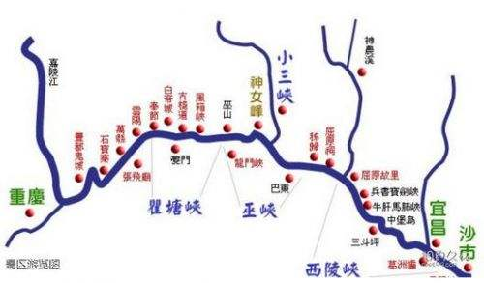
审题
书信体中的建议信：用跟建议有关的语言；
朋友之间的回信：不用太过正式的语言；
二选一：最后应该有一个你的推荐路线；
理由：你的推荐角度应基于Jim的兴趣爱好或者中国人推荐外国游客旅行线路的角度；
结尾：祝中国之行愉快，旅途愉快，或者相信这会是一段难忘的旅程等。
高中 英语

Slide 9
二选一
I’m writing to offer you some advice about your travel route. If I were you, I would definitely choose the tour along the Yangtze River/the trip to Mount Tai.
个人感觉：语言上没有什么毛病，但是从实际交际来看，如果对方让你二选一，你说当然选某个，你的潜台词是不是：这样简单的选择都要问，你傻啊？所以应用文写作一定要根据审题的实际情况，用热情，礼貌，真诚的语言语气达到交际功能。
高中 英语

Slide 10
二选一
所以比较能让对方接受的说法是：两个都很好，的确都很值得一游。这样的情况要二选一，你的犹豫是有道理的。我完全明白。
I can fully understand your hesitation. Both of the trips are highly recommended.
Both of the two scenic spots are well worth visiting.
It’s really a hard decision to make.
高中 英语

Slide 11
考虑一下Jim这个人的兴趣爱好
完全是你说了算
Since you are fond of relaxing travel,
I think the tour along the Yangtze River will be more suitable for you. Besides, you are always curious about the lives of the local people in China, and now you will have the golden opportunity to explore and experience while travelling along the River.
Travel Route A
高中 英语

Slide 12
Taking your interest into consideration, I think the tour along the Yangtze River is the better choice. As the longest river and one of the mother rivers of Chinese civilization, the Yangtze will present you with amazing scenery with many well-known sightseeing spots, which will definitely be a feast for your eyes. Time permitting, you can also experience the lives of the local people along the river, enabling you have a deeper insight into Chinese customs and culture.
高中 英语

Slide 13
考虑一下Jim这个人的兴趣爱好
这个完全是你说了算，
Since you are a keen lover of mountain climbing, I think climbing Mount Tai will give you an entirely different experience. Even better, enjoying a fantastic sunrise at the top of the mountain is bound to be a cherished memory in your lifetime.
Travel Route B
高中 英语

Slide 14
You will be greeted with a fantastic view along the tour: lofty mountains, winding rivers, clean waters and unique landscape on the banks.It will be a feast for your eyes.
Admiring the sunset on a luxurious cruise ship will surely be an unforgettable experience.By the way, you will have a chance to taste the mouth-watering local flavor, which is totally different from that in your hometown.
高中 英语

Slide 15
Some other reasons for your recommendation
It is no exaggeration to say that he who doesn’t reach the top of Mount Tai is not a true climber.
It’s no easy task to get to the top of the mountain, but when you eventually get there, you will find all your efforts worthwhile.
Overlooking the city beneath or surrounded by the fairy-tale-like cloud sea, you will undoubtedly feel rewarded.
Not only can you admire the most famous mountain in China, you can also visit the birthplace of Confucius, the first teacher in the world.
高中 英语

Slide 16
Best wishes
Hope you will have a good time in China.
Positive prediction
I guarantee you will have an enjoyable and unforgettable trip in China.
高中 英语

Slide 17
假如你是英国留学生李华。你就读学校的附近新落成一家书店。为增加访客量,书店经理Mr. Smith现向读者征求建议。请你给他写封建议信,内容包括:
1.写信目的;
2.你的建议;
3.你的期待。
注意:
1.词数80左右;
2.可适当增加细节,以使行文连贯

Slide 18
"It would be appreciated it you could take my suggestions into consideration."
"Looking forward to your reply."
这封建议信是书店经理有求于读者，所以作为读者的李华向对方提供建议，被感谢的不应该是书店经理而是李华本人。事实上，建议信一般可以分为主动提供建议还是被动寻求建议，像上篇例文中的李华就是被动寻求建议，因而他不需要去感谢书店经理，他可以表示期待也可以表示祝愿，可以期待建议有用，祝愿书店生意兴隆，但是要说感谢那就搞错对象了，looking forward to your reply就更扯了，难道期待对方回个礼？

Slide 19
主动提供建议参考的，比如教材选修7 第一单元的副文
这封建议信是Alic主动写给市政设计师Sanders的，要求她设计电影院时能考虑残疾人的需求，并且主动提供了一些建议。在文章的末尾，她对此表达感谢，说的也十分委婉。

Slide 20
假定你是李华,你校来自爱尔兰的外教Peter因病回国休假请给他写一封电子邮件,内容包括:
1.询问近况:
2分享班级最新消息
3表达祝愿
注意:1.词数80左右:2.可适当增加细节以使行文连贯

Slide 21
这封信的要点只有询问近况,分享信息表达祝愿
首先这是一篇什么体裁的应用文？写信初衷是什么？
还需要哪些细节的考虑？
班级的信息分享,是和外教有关的信息;既然对方生病了,肯定要鼓励他坚强还有对未来是也期待下重新回校执教的那天呢；
比如对外教的思念、互动、鼓励期待;因为回国休假长期不见,所以思念;因为是自己的老师,所以表示感激；
所以有时为什么一篇语言看似普普通通的文章却得了一个高分,因为它做到了那些隐含的细节考虑,让文章显得更加生动真实,自然而有人情味

Slide 22


Why do we write thank-you letters?
Thank You: the two most important words!
The power of saying "thank you" cannot be overstated.
Thank you letters only take a few minutes to write but they carry a lot of weight, but can make someone else feel appreciated and special.
高中 英语

Slide 23

How to Write a Thank You Statement
Start with a clear “Thank you.” For example, “Thank you for taking the time to meet with me today.”, “Thank you for your thoughtful gift.” or “Thank you for your hospitality and generosity during my stay in London.”
sincere/grateful tone
高中 英语

Slide 24
How to Write Thank You Details
After you’ve expressed your thanks, elaborate with details about why you’re thanking somebody.
If you’re thanking a friend for a gift, explain why you’re particularly grateful for it. Perhaps the new bike has enriched your after-school life and made you fall in love with cycling.
sincere/grateful tone
高中 英语

Slide 25
How to Write a Final Thank You Statement
End with one more Thank you statement. After you’ve offered a little detail to illustrate your gratitude, offer one more word of thanks. Consider something along the lines of “Thank you again for everything you have done for me.” or “Thank you again for your thoughtfulness. It meant the world to me.”
sincere/grateful tone
高中 英语

Slide 26
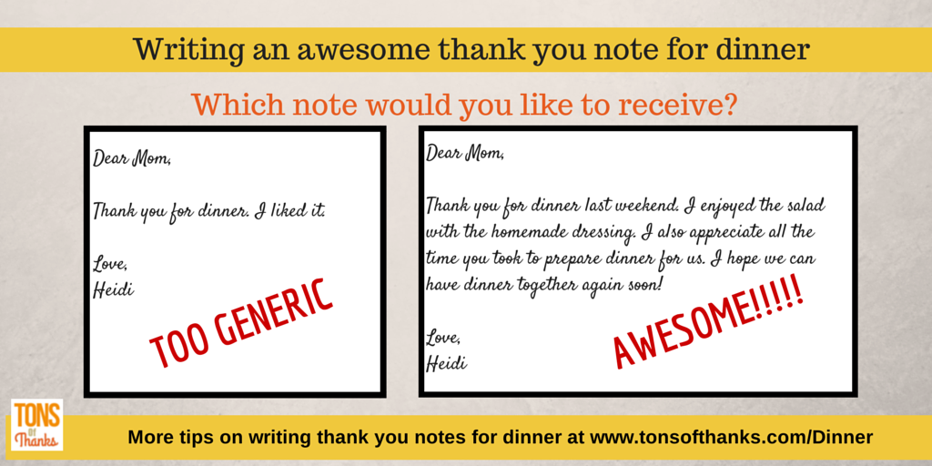
3.感谢信
I also appreciate all the time you took to do sth...
高中 英语

Slide 27

2019年浙江高考真题
假定你是李华，经常帮助你学习英语的朋友Alex即将返回自己的国家。请给他写一封邮件，内容包括：
1.表示感谢；
2.回顾Alex对你的帮助；
3.临别祝愿。
高中 英语

Slide 28
Dear Alex,
Learning that you’re leaving for the United States soon, I’m eagerly writing to express my heartfelt gratitude to you for your help.
During the past three years, it’s so nice of you to have offered me classes of practical learning skills. Under your professional guidance, I have made unbelievable progress in English. It’s really a pleasant surprise for me to even rank first in a recent English speech contest. Whenever I encounter difficulties, you always cheer me up and help me out, which fuels my enthusiasm for English and promotes me to regain tremendous confidence. No words are strong enough to convey how grateful I am.
Thanks again and wish you a pleasant journey home.
高中 英语

Slide 29
Dear Alex,
I’ve heard you’ll go back to your country and I’d like to thank you for your help with my English during your time in China.
Our past conversations not only enhanced my oral skills, but also taught me about your country’s unique etiquette and culture. Furthermore, you have been a patient teacher, giving me precious advice on how to improve my academic performance at school. I am now more passionate about English, as I’m intrigued by your amazing stories.
Have a safe trip and may you succeed in whatever you do.
Best regards,
高中 英语

Slide 30
Dear Alex,
Your stay here has given me a time so joyful and inspirational and it’s such a hard thing for me to say/bid farewell.
Surely, it’s your encouragement and instruction that’ve helped improve my spoken English, which used to be a barrier to hinder me from communicating with others freely. Also, your abundant knowledge of various cultures just inspire me to embrace different people and ideas. Most important is that lit by your optimism, I’ll always be ready to face future challenges bravely.
Long distance separates no bosom friends and let’s long for next get-together. Best wishes to you.
高中 英语

Slide 31
假定你是李华，最近，你在英语学习上遇到一些困难。请给你的英国朋友Alex写一封邮件，向他求助。
内容包括：
1.你的困难；
2.寻求帮助。
注意:
1.词数80左右；
2.可以适当增加细节，以使行文连贯。
试题

Slide 32


Para 1:
1. 问候：
2. 背景：在英语学习上遇到一些困难
目的：写一封邮件，向你求助
Framework
Para 2:
1. 你的困难1+ 你的困难2
Para 3:
1. 表示感谢；
2. 期待回复。

Slide 33


1. 问候
Para 1
How is everything going with you?
How are things going with you?
How are you doing?

Slide 34
I find it difficult/challenging/demanding to learn English well. So I’m writing to ask you for help.
Para 1
I find it really a challenge/headache for me to learn English well. So I'd like to turn to for help and guidance.
I have problems with my English learning, and would like to have your advice to help me out.
These days I have been struggling with my English learning. Therefore, I badly need your help.
2. 背景+目的
Faced with the challenge of learning English well, I'm writing for your generous help and assistance.
I'm writing to ask you to do me a favor with my English learning.

Slide 35
1. 一般只写两个困难；
2. 应该围绕“英语学习”来展开。
你的困难
Para 2
Possible difficulties/ challenges：
1. memorize words– poor vocabulary
2. communicate with native speakers
3. writing skills
4. academic performance in English
5. essay writing
6. ...

Slide 36
你的困难
Para 2
Tips（表达拓展）
1. 本段落建议采用“总-分”或者“总-分-总”结构, 用3-4句话完成。
2. 用定语从句、非谓语动词做状语、状语从句等拓展句子结构的丰富性，从原因、目的、结果等角度来拓展表达的宽度和深度。

Slide 37
你的困难
① I have difficulty in remembering English words, which accounts for my limited vocabulary.
定语从句拓展
Para 2
② I often fail to manage the proper use of English words, putting me in an embarrassing situation.
分词作结果状语
③ Though having learned English for years, I find that communicating with native speakers in English remains a big headache to me.
分词作状语，doing作主语
④ I really have no idea how to improve my listening skills.
⑤ What troubles me most/my primary concern is that I often perform poorly in English exams, however hard I work.
让步状语从句拓展

Slide 38
1. 表示感谢(事先)；
2. 期待回复。
① Thanks in advance for your time and advice. Looking forward to your earliest reply.
② I would be very appreciative/grateful/thankful if you could reply to me at your earliest convenience. Thank you in advance.
④ I would appreciate it if you could give me a hand and I'm looking forward to your earliest reply.
⑤ I would highly appreciate your timely/prompt reply.
⑥ Your timely/prompt reply would be highly appreciated.
Should you be kind enough to give me any help, I would be grateful to you.
Para 3
无灵主语句

